Slide 1
RAPID DECISION
FINAL EXPENSE & GUARANTEED ISSUE

Slide 2
About the Products
Fidelity Life’s Rapid Decision Final Expense and Guaranteed Issue Graded Death Benefit policies were developed for agents to have an efficient “final expense” solution for this ever growing segment of the life insurance marketplace.
.

Slide 3
Rapid Decision Final Expense
Simplified Issue Final Expense Whole Life
(Final Expense) is a simplified issue Whole
Life Insurance policy available from Fidelity
Life Association
Level Benefit available immediately*
Face Amounts from $5,000 to $35,000**
Issue Ages from 50-85
Age last birthday
Guaranteed level benefits
Cash Value and Reduced Paid-Up Insurance available
Tobacco and Non-Tobacco rates
*Assuming PI can answer all medical questions on application “NO”
**Minimum Face Amount for WA is $25,000

Slide 4
Rapid Decision Final Expense
The Final Expense policy has an Accelerated Death Benefit rider included at no additional cost on all policies (where approved)
Advances a portion of the base plan death benefit upon proof that the insured has a life expectancy of 12 months or less
Amount advanced plus interest is treated as a lien against the future death benefit
Monthly interest at rate equal to the greater or 7% annually or the published 90 day US Treasury bill rate at date the accelerated benefit is paid
Maximum is the lesser of 50% of the death benefit or $10,000
Minimum $2,500 accelerated benefit

Slide 5
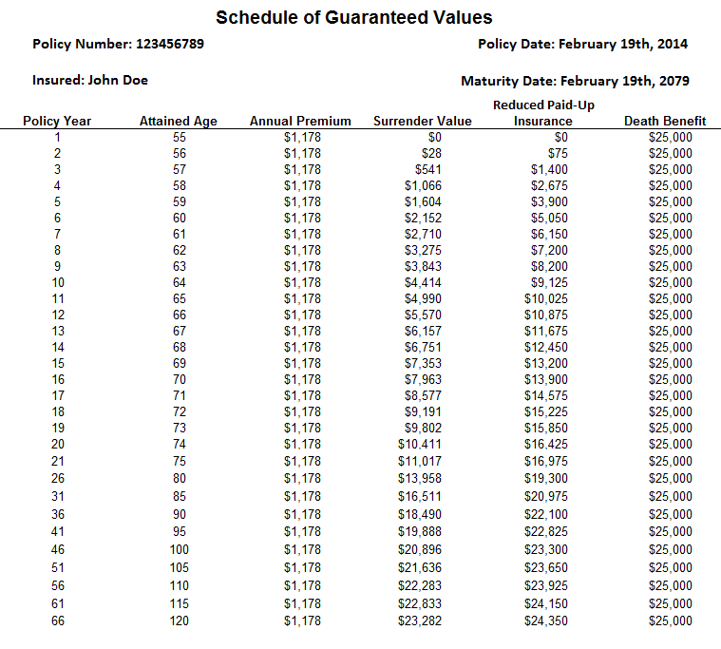
Final Expense Policy Schedule
The biggest selling point for FE is that the premiums & death benefit are guaranteed level through age 120
There is a cash value component to the FE product, and for some customers this will be an important feature to point out
In addition to cash value the FE policy has a “Reduced Paid-Up” option. Basically the customer can choose to stop paying, and be guaranteed some coverage for the rest of their life

Slide 6
Final Expense: What is Simplified Issue?
Final Expense will be underwritten on a simplified issue, accept/reject basis:
All medical questions must be answered “NO”
Answers to the medical questions will be independently verified through MIB, Rx and MVR database checks
Because of this it’s important to become familiar with the application, so you know which conditions are acceptable before attempting to place customers in an FE policy
It’s also very important that you ask the questions VERBATIM, and allow the customer to respond with a clear “YES” or “NO”…no coaching, no leading.

Slide 7
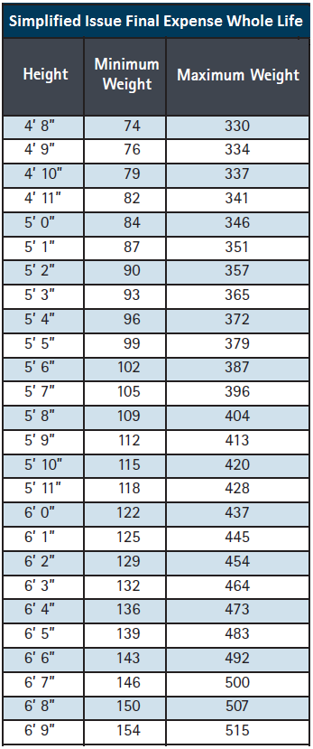
Final Expense Pre-Qualification
Proposed Insured must be a U.S. Citizen or permanent resident – no visas
There is a build chart for the Final Expense
Non Tobacco and Tobacco rate classes apply as determined by the use or non-use of any form of tobacco in the past 12 months.
Yes = Tobacco rate
No = Non Tobacco rate

Slide 8
Final Expense Pre-Qualification
For the Final Expense (level benefit), all of the following questions must be answered “NO”…..If any answers are “YES”, the Proposed Insured is NOT qualified for the Rapid Decision Final Expense, and may be offered the Rapid Decision Guaranteed Issue.
Are you currently on oxygen for a medical condition, or confined to a nursing facility or assisted living facility?
Within the past six months, have you been hospitalized two or more times, or have you been advised by a member of the medical profession to have any hospitalization or to be admitted to a nursing facility that has not yet been completed?
Have you been diagnosed by a member of the medical profession as having a life expectancy of 24 months or less?
Have you ever been diagnosed by a member of the medical profession as having Acquired Immune Deficiency Syndrome (AIDS) or AIDS Related Complex (ARC), or tested positive for Human Immunodeficiency Virus (HIV)?
Within the past 5 years have you been convicted of any felony or driving under the influence of alcohol or drugs?
Within the past 2 years have you been diagnosed with, consulted a member of the medical profession or been treated for:
heart attack, stroke, chest pain, coronary artery disorder, Transient Ischemic Attack (TIA) or any other disorder of the heart, blood vessels or peripheral vascular system?
Chronic Obstructive Pulmonary Disease (COPD), emphysema or any other respiratory disorder other than asthma?
kidney disorder, liver disorder, any organ transplant, or diabetic complications (amputation, coma, or blindness)?
Alzheimer's disease, dementia, organic brain syndrome, cognitive impairment (of any degree), or Amyotrophic Lateral Sclerosis (ALS)?
cancer (other than basal cell skin cancer)?
Within the past 2 years have you been counseled, treated, advised to discontinue or seek treatment for use of illegal drugs, alcohol or prescription drugs?
Within the past 2 years have you been hospitalized for a mental disorder?
Within the past 2 years, have you been advised by a member of the medical profession, to have any medical test (other than related to HIV/AIDS) that has not yet been completed?

Slide 9
Rapid Decision Guaranteed Issue
Guaranteed Issue Graded Death Benefit (“GI”) is a No Medical Questions / No Medical Exam Insurance policy available from Fidelity Life Association:
Guaranteed Issue
Face Amounts from $5,000 to $20,000**
Issue Ages from 50-85
Age last birthday
Quotes through Rapid App
Guaranteed level benefits until maturity date of 121
Cash Value and Reduced Paid-Up Insurance available
Non Tobacco and Tobacco rate classes apply as determined by the use or non-use of any form of tobacco in the past 12 months.
Yes = Tobacco rate
No = Non Tobacco rate
**Not Available in Washington due to low face amount regulation

Slide 10
Rapid Decision Guaranteed Issue
Graded Death Benefit
Non-accidental death benefits (as defined in policy) are reduced during first three policy years. These reduced death benefits are equal to premiums paid plus 5% interest.
The full face amount is paid for accidental deaths (as defined in the policy) during the first three years.
In policy years 4 and beyond, the full death benefit is payable for all causes of death.

Slide 11
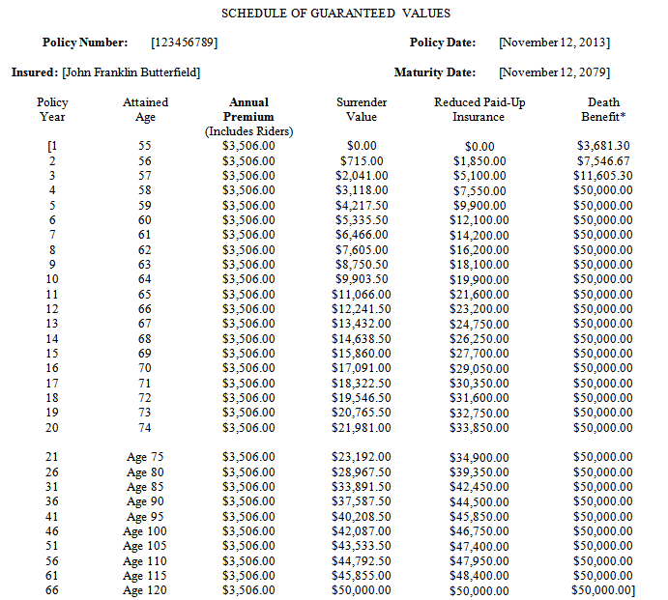
Guaranteed Issue Policy Schedule
The biggest selling point for GI is that the premiums & death benefit are guaranteed level through age 120
There is a cash value component to the GI product, and for some customers this will be an important feature to point out
In addition to cash value the GI policy has a “Reduced Paid-Up” option. Basically the customer can choose to stop paying, and be guaranteed some coverage for the rest of their life

Slide 12
Quick Quote & Application Submission
Pre-qualification* should determine which product is available to the Proposed Insured. Then products can be quoted by logging into Rapid App and using the Quick Quote feature.
Note: There are Non Tobacco and Tobacco rate classes for both the Final Expense and the Guaranteed Issue products, as determined by the use or non-use of any form of tobacco in the past 12 months. Yes = Tobacco rate, No = Non Tobacco rate
* See 9 pre-qual questions on previous slide

Slide 13
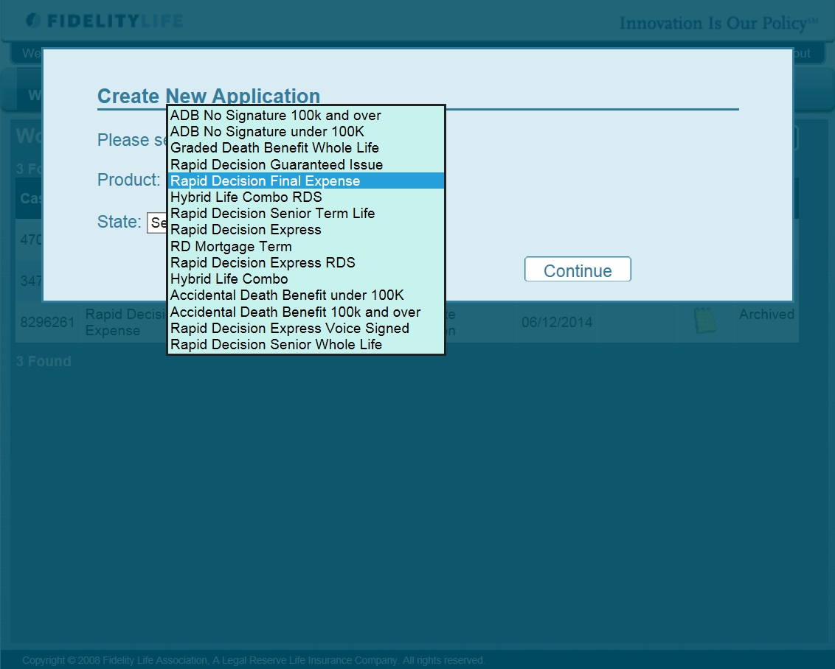
Rapid App- Final Expense
For Final Expense Application: Log in to Rapid App and select Rapid Decision Final Expense.

Slide 14
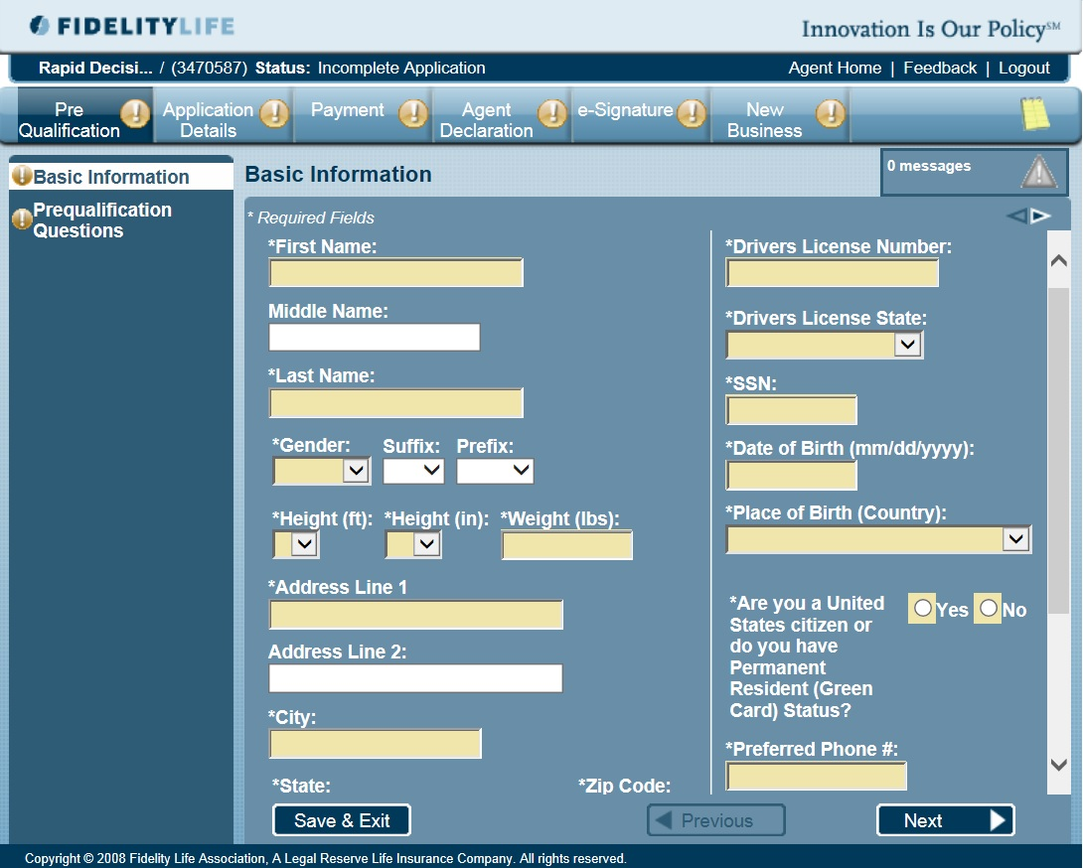
Final Expense Application
Fill out the application as you normally would. Make sure to fill in any field that is in yellow, or that is marked with
an asterisk

Slide 15
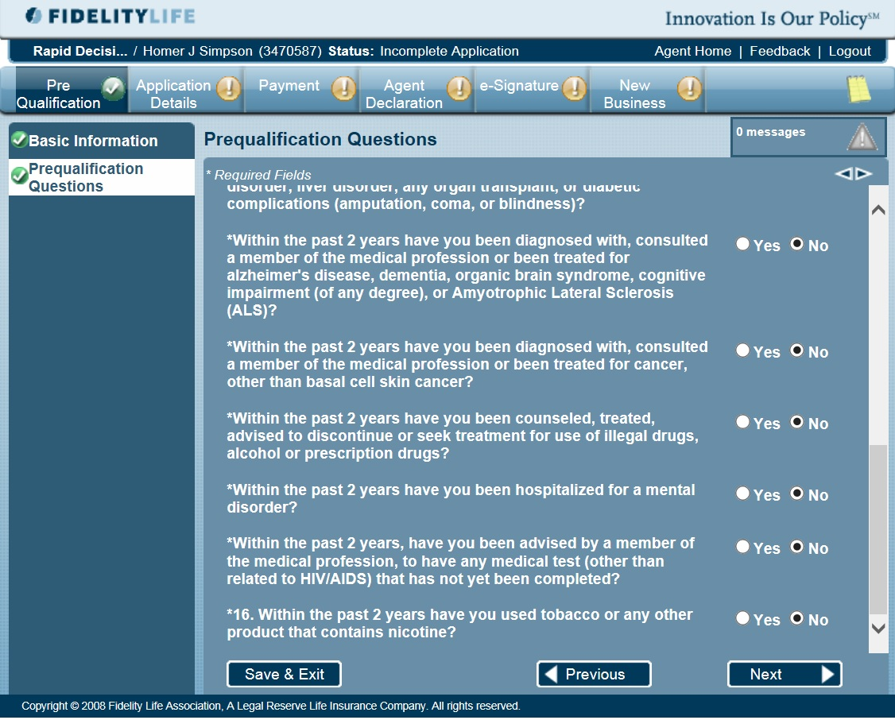
Final Expense Application - 2
If you have already pre-qualified the person by asking all the pre-qual questions in application format, you will be able to go thru this page quickly.

Slide 16
Final Expense Application - 2
Remember, the Final Expense and Guaranteed Issue DO ask about Tobacco/Nicotine use. That’s because there are Tobacco & Non-Tobacco rates for both the FE & GI products.
To get Non-Tobacco Rates , the PI must not have used any form of tobacco in the past 12 months.
Note: If tobacco use question is answered YES, a follow up will determine use in past 12 months…

Slide 17
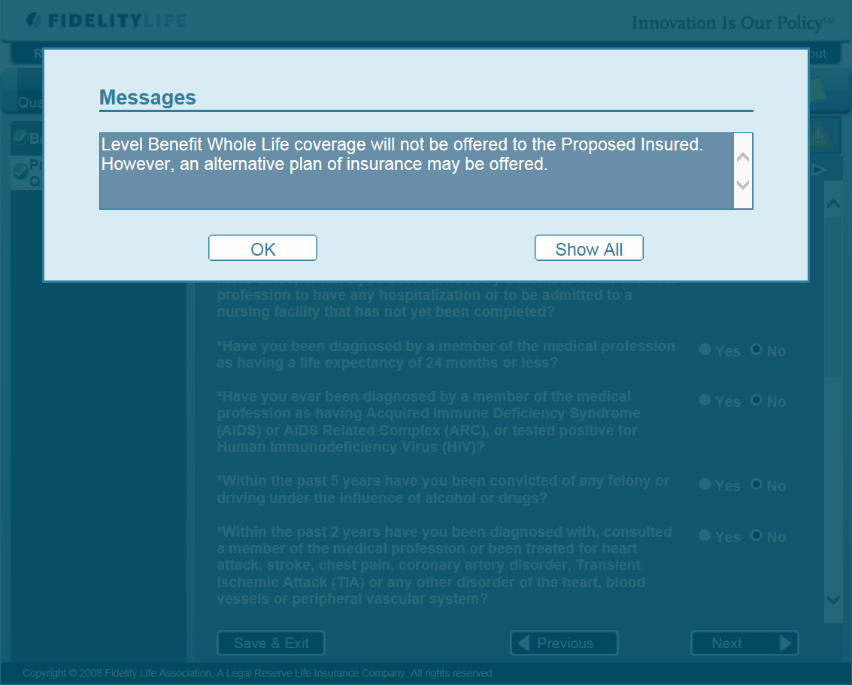
Final Expense - Medical Questions
If by chance you do not prequalify the applicant and/or he/she answers YES to any of the health/lifestyle knock out questions in Rapid App, you will be notified that the Final Expense is not available, but an alternative may be offered…you can still proceed and submit the application…
Click “OK” and continue…..

Slide 18
Final Expense Coverage Applied For
When you get to the “Coverage Applied For”…please note that the system can only quote and show the rates for the product that was selected in the drop down when creating this application. So, if you are proceeding upon receiving the message on previous slide, do not give your applicant the rates being shown…open another browser to quote the alternative plan (Guaranteed Issue).

Slide 19
Final Expense - Submitting the Application
Once you have completed the entire application and everything is “checked” off in green you will need to get the e-Signature via DocuSign.
(separate presentation available)
.
Once the application is signed by applicant, it automatically goes to New Business and to underwriting, where a decision should come back within 24 hours (Standard Processing).
For approvals, an underwriter pulls the MIB, Rx & MVR reports, and makes a decision based on that data and the application. The customer receives either Standard Non-Tobacco or Standard Tobacco rate as applicable and/or an alternative plan as applicable.

Slide 20
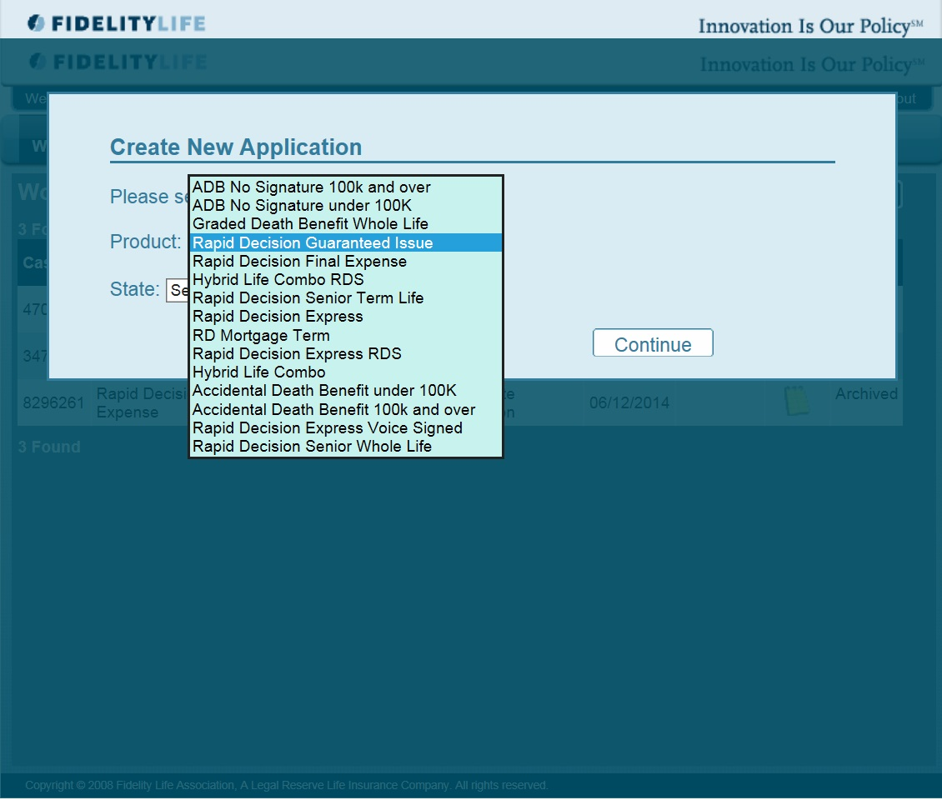
Rapid App – Guaranteed Issue
If your pre-qual determines your applicant is not qualified for the Final Expense product….Start your application process in Rapid App with creating a new application, selecting the Rapid Decision Guaranteed Issue.

Slide 21
GI - Filling out the Application
Fill out the application as you normally would. Make sure to fill in any field that is in yellow, or that is marked with an asterisk

Slide 22
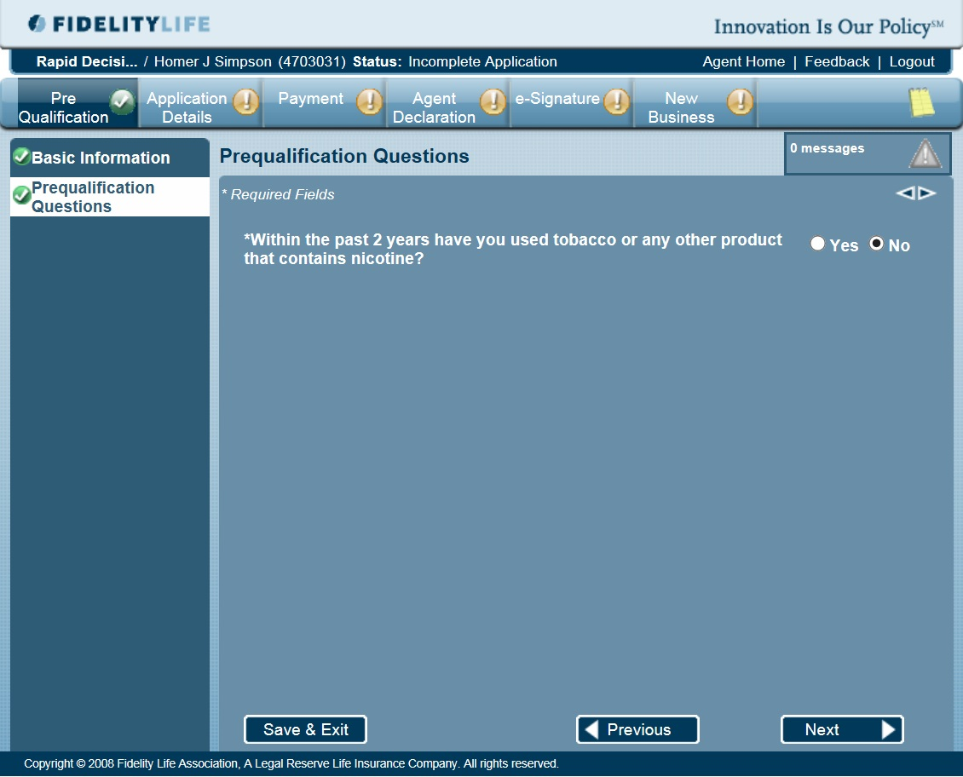
Rapid Decision Guaranteed Issue
Remember, the Guaranteed Issue, like the Final Expense policy DOES ask about Tobacco/Nicotine use.
To get Non-Tobacco Rates , the PI must not have used tobacco in the past 12 months.
There are NO medical questions. This is the only underwriting question on the application.

Slide 23
GI - Submitting the Completed Application
Once you have completed the entire application and everything is “checked” off in green you will need to get the e-Signature via DocuSign.
(separate presentation available)
.
Once the application is signed by customer, it automatically goes to New Business will be processed within 24 hours (Standard Processing).
Since there is no Underwriting, the customer receives either Standard Non-Tobacco or Standard Tobacco rate as applicable and/or an alternative plan as applicable.

Slide 24
Rapid Decision Final Expense and Guaranteed Issue-GDB Products review
Simplified Issue policy for ages 50 to 85 with just a few questions
Competitive rates with full all-cause coverage day one!
Accelerated Death Benefit rider in the event the customer is diagnosed as terminally ill (no additional cost)
Coverage amounts from 5K to 35K
Anyone that is Age 50 to 85 that is an US Citizen and has a Payment method can get coverage!
No Exam / No Underwriting!
3 yr Graded Period that pays premiums back plus 5% interest
Coverage amounts from 5K to 20K
Final Expense
Fidelity’s FE and GI-GDB give you a new way to get your customer’s coverage!

